Slide 1


Team 26: Voice-Controlled Robot
Bi-Weekly Update 4 Logan Cardwell, Dawson Holly,
Nicholas McCray, Cameron Schoenfeld Sponsor: Zhewen Hu TA: Zhewen Hu
Notes:
Michelle

Slide 2
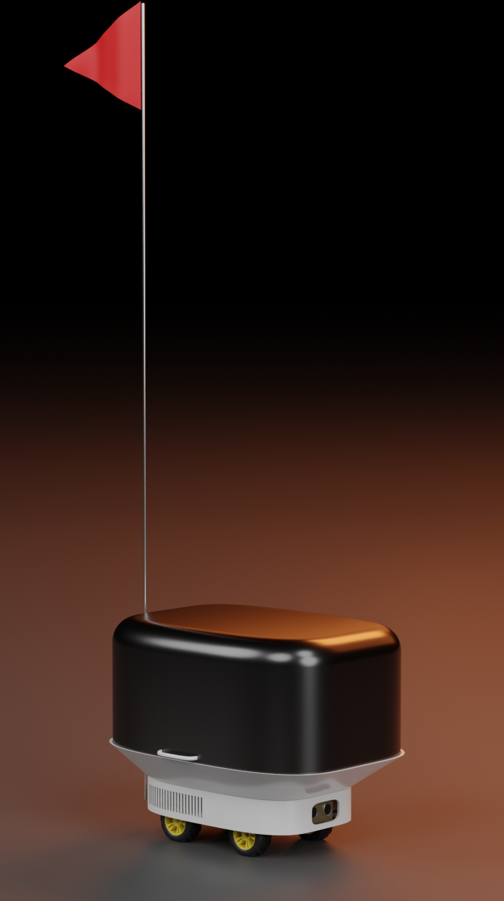
Project Summary
The restaurant industry can be streamlined with the inclusion of automated service robots to deliver food directly to the customer without the need of human waitstaff.
The robot is able to take in voice commands and manual control from a mobile application to direct its movement while sensors detect and prevent imminent collisions. Additionally, the robot will be able to navigate through a predetermined map of the environment to quickly navigate to any marked location.
Notes:
Cameron

Slide 3
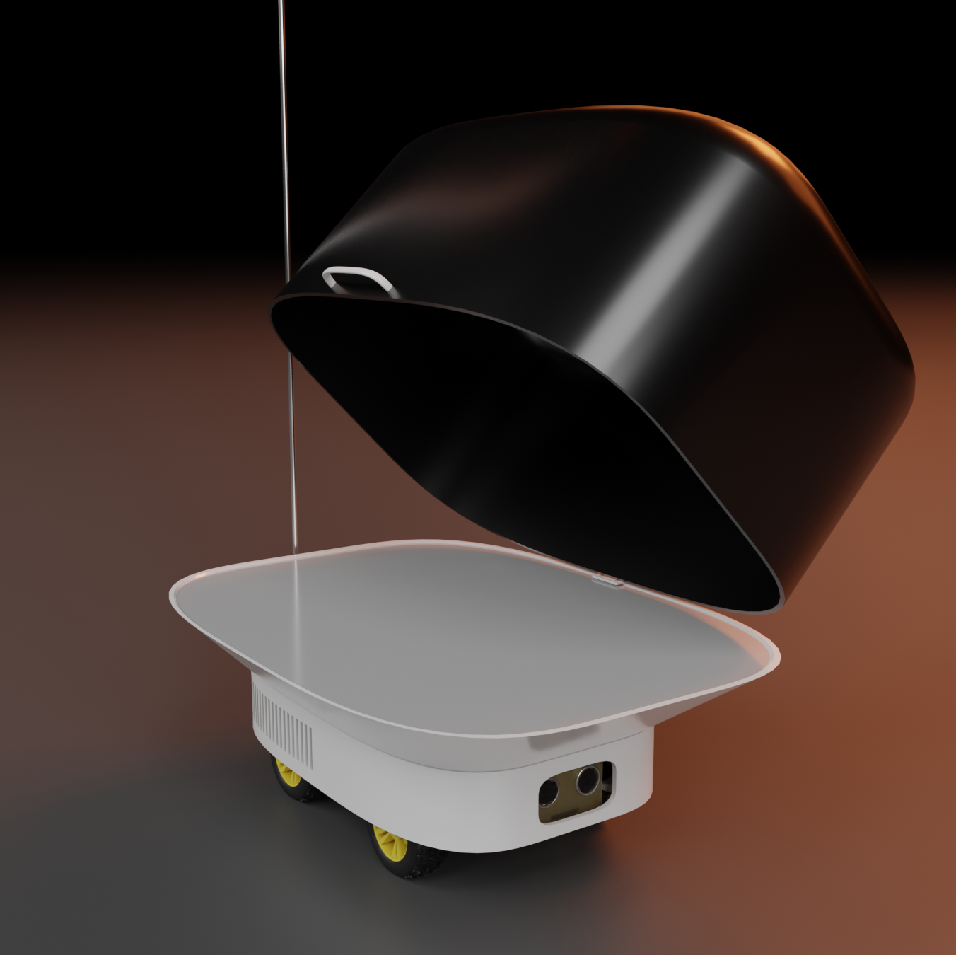
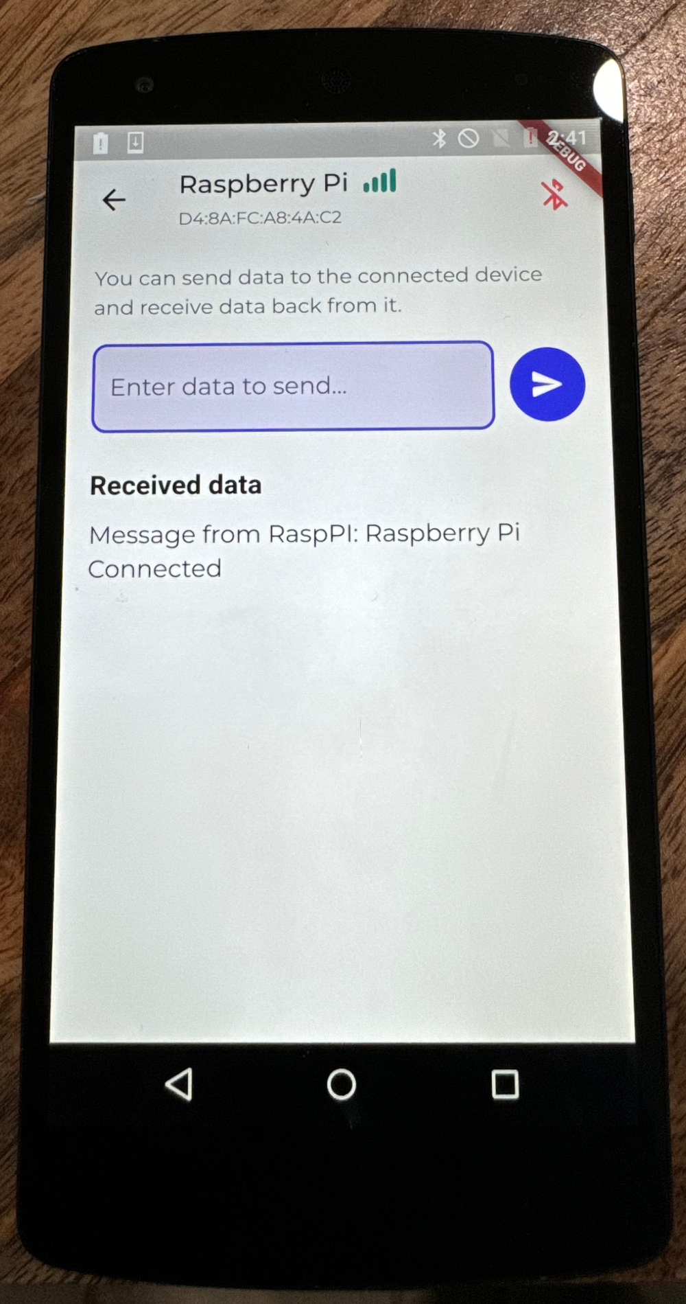
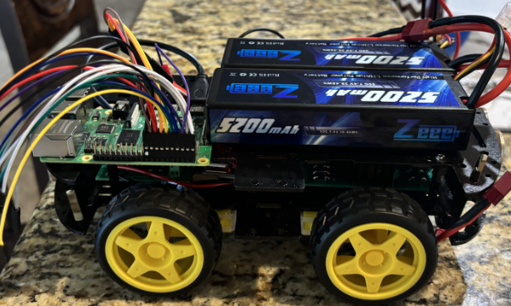
Integrated System Diagram
Body design to protect the robot from food spills and general damage.
Manual control signal / audio file transmission to give robot instructions via Bluetooth.
Feedback to app when instructions are completed or when obstacles are encountered.
Pathfinding to specified locations with collision avoidance.
Notes:
Eric

Slide 4
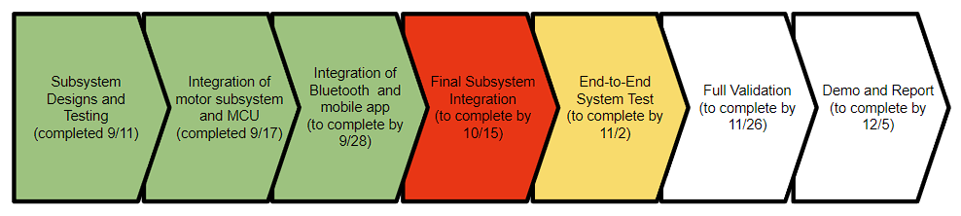
Project Timeline
Notes:
Eric

Slide 5
Logan Cardwell
Accomplishments since last update 9 hrs of effort | Ongoing progress/problems and plans until the next presentation
Body was entirely redesigned to accommodate new motor driver positioning change that occurred last lab which also forced the Raspberry Pi into a different position. | Printing on the first part of the body will begin tomorrow, and after the fit is verified, the rest of the parts will be printed. While parts are being printed, I will work on speeding up integration by picking up slack on the audio processing code.

Slide 6
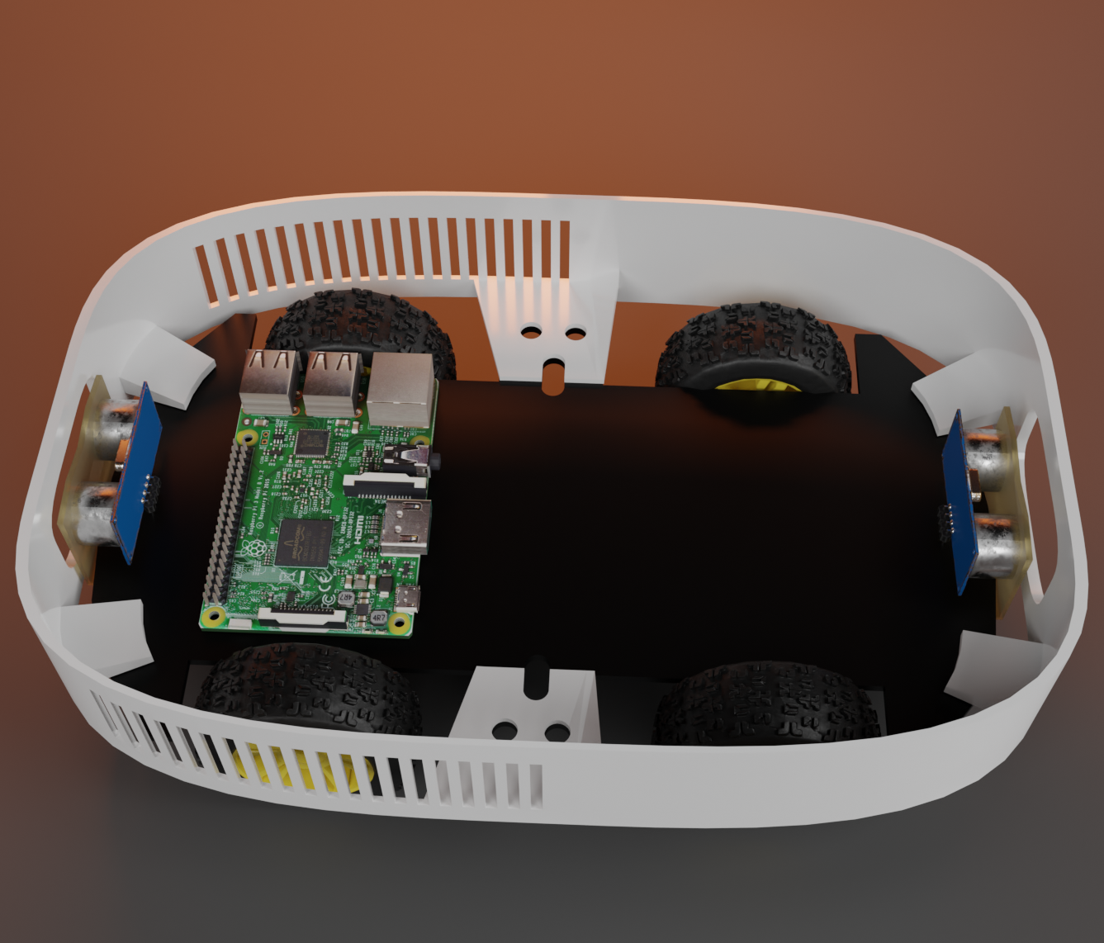
Logan Cardwell
The new body design has vents on the side and a shorter frame given the pi is now on the lower level.
The construction is now separated into 3 pieces instead of 2 with a weight-bearing piece, attachable tray platform, and hinged food cover.

Slide 7
Dawson Holly
Accomplishments since last update 10 hrs of effort | Ongoing progress/problems and plans until the next presentation
Installed new PWM Motor Driver. Adjusted Speeds. Completed re-design to allow for fitting of the driver. | Attach outer shell. Complete all Integration. Longevity testing. Max carrying capacity. Mount on off switches. Mount the raspberry pi in box.

Slide 8
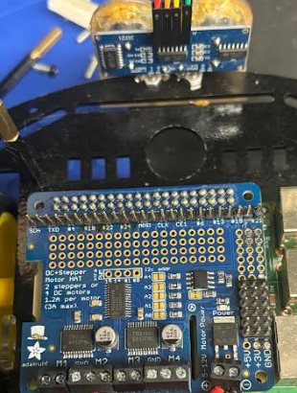
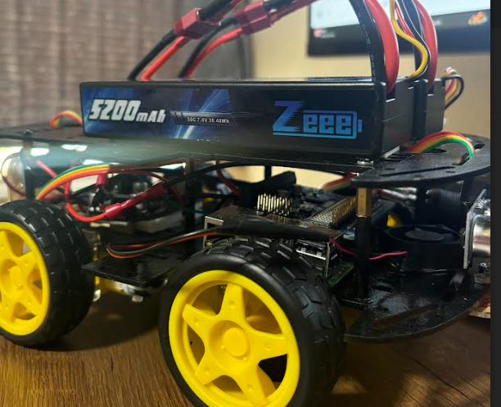
Dawson Holly
Now utilize a raspberry pi Hat.
More stable and secure connections

Slide 9
Nicholas McCray
Accomplishments since last update 10 hrs of effort | Ongoing progress/problems and plans until the next presentation
Completed app sending data to Raspberry Pi via BLE. | App receiving sensor data from Raspberry Pi. Voice file transmission and compatibility with machine learning.

Slide 10
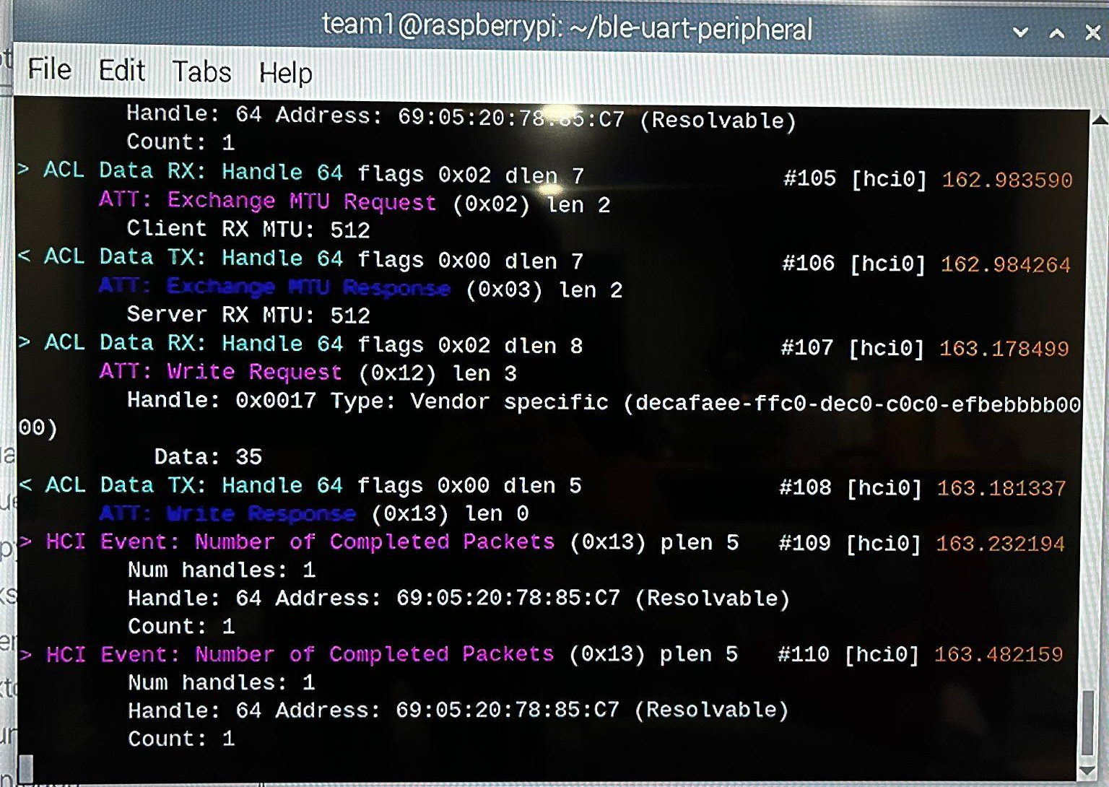
Nicholas McCray
First two lines indicating MTU negotiation between client and server
Line 3 indicating a write request, data “35” is in ASCII Hex which translates to the character “5”
Line 4 indicating the server acknowledging the write request

Slide 11
Cameron Schoenfeld
Accomplishments since last update 8 hrs of effort | Ongoing progress/problems and plans until the next presentation
Completed modifications to motor control code and testing new motor driver board and Pi hat. Continued work to ensure proximity sensor functionality with movement functions. | Work during Blitz to integrate App and Voice Recognition software. Creation of finalized virtual map for demo.

Slide 12
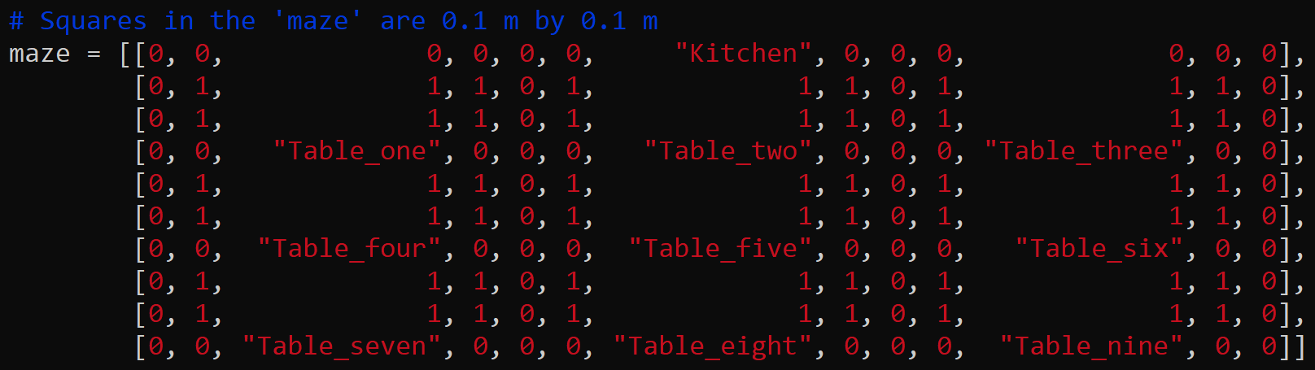
Cameron Schoenfeld
Original test map to be modified for demo:

Slide 13
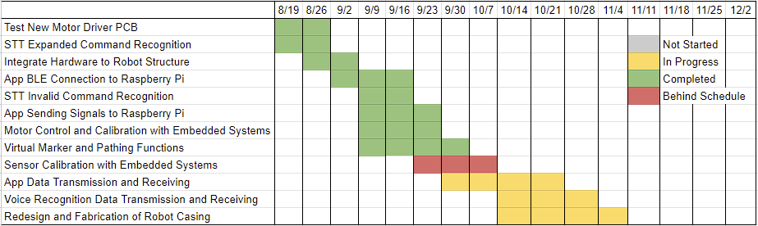
Execution Plan
Notes:
Michelle

Slide 14
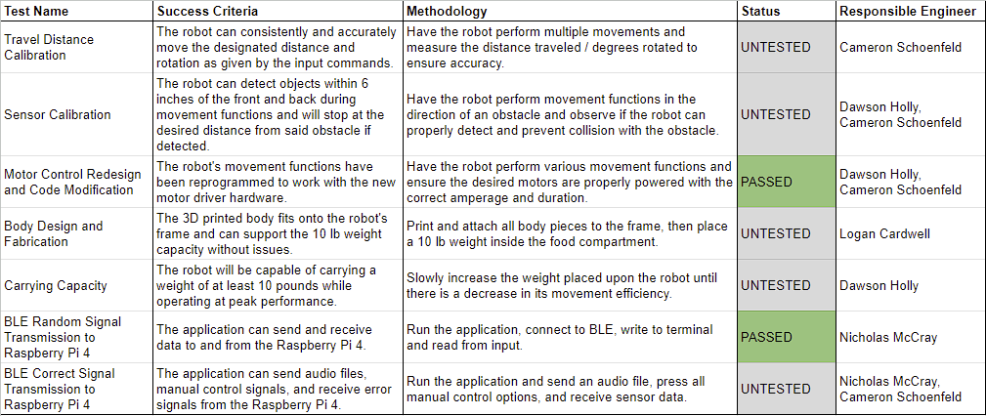
SYSTEM Validation Plan
Notes:
Michelle

Slide 15
Thank You
Any Questions?

